Slide 1
World System Theory- International Relations

Slide 2
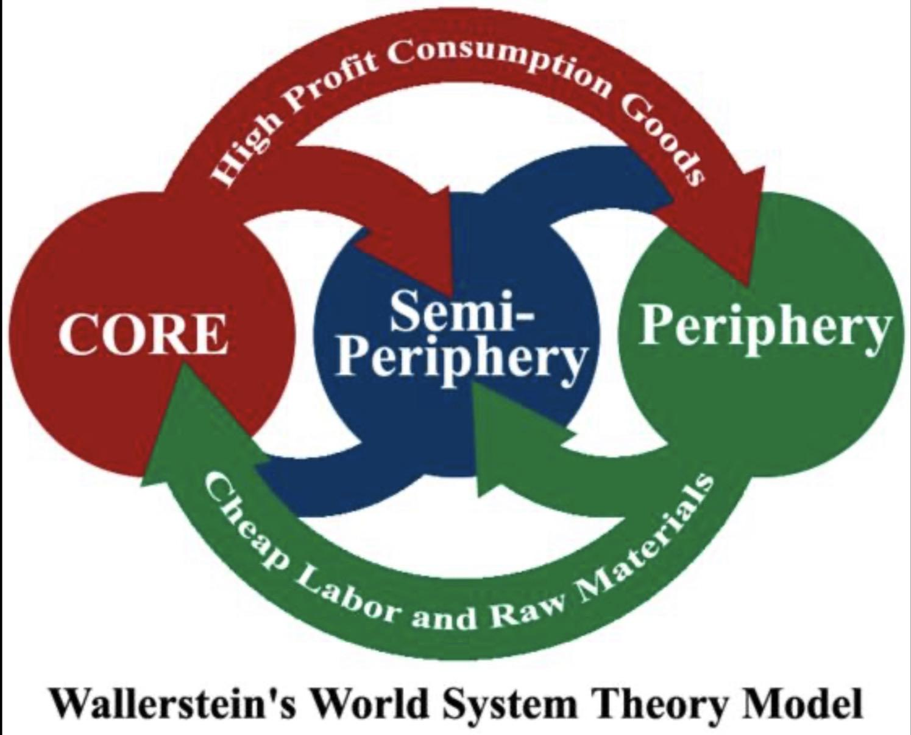

Slide 3
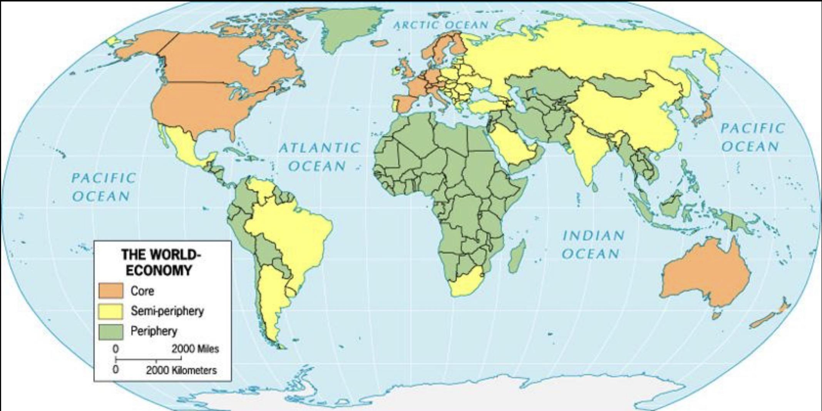

Slide 4
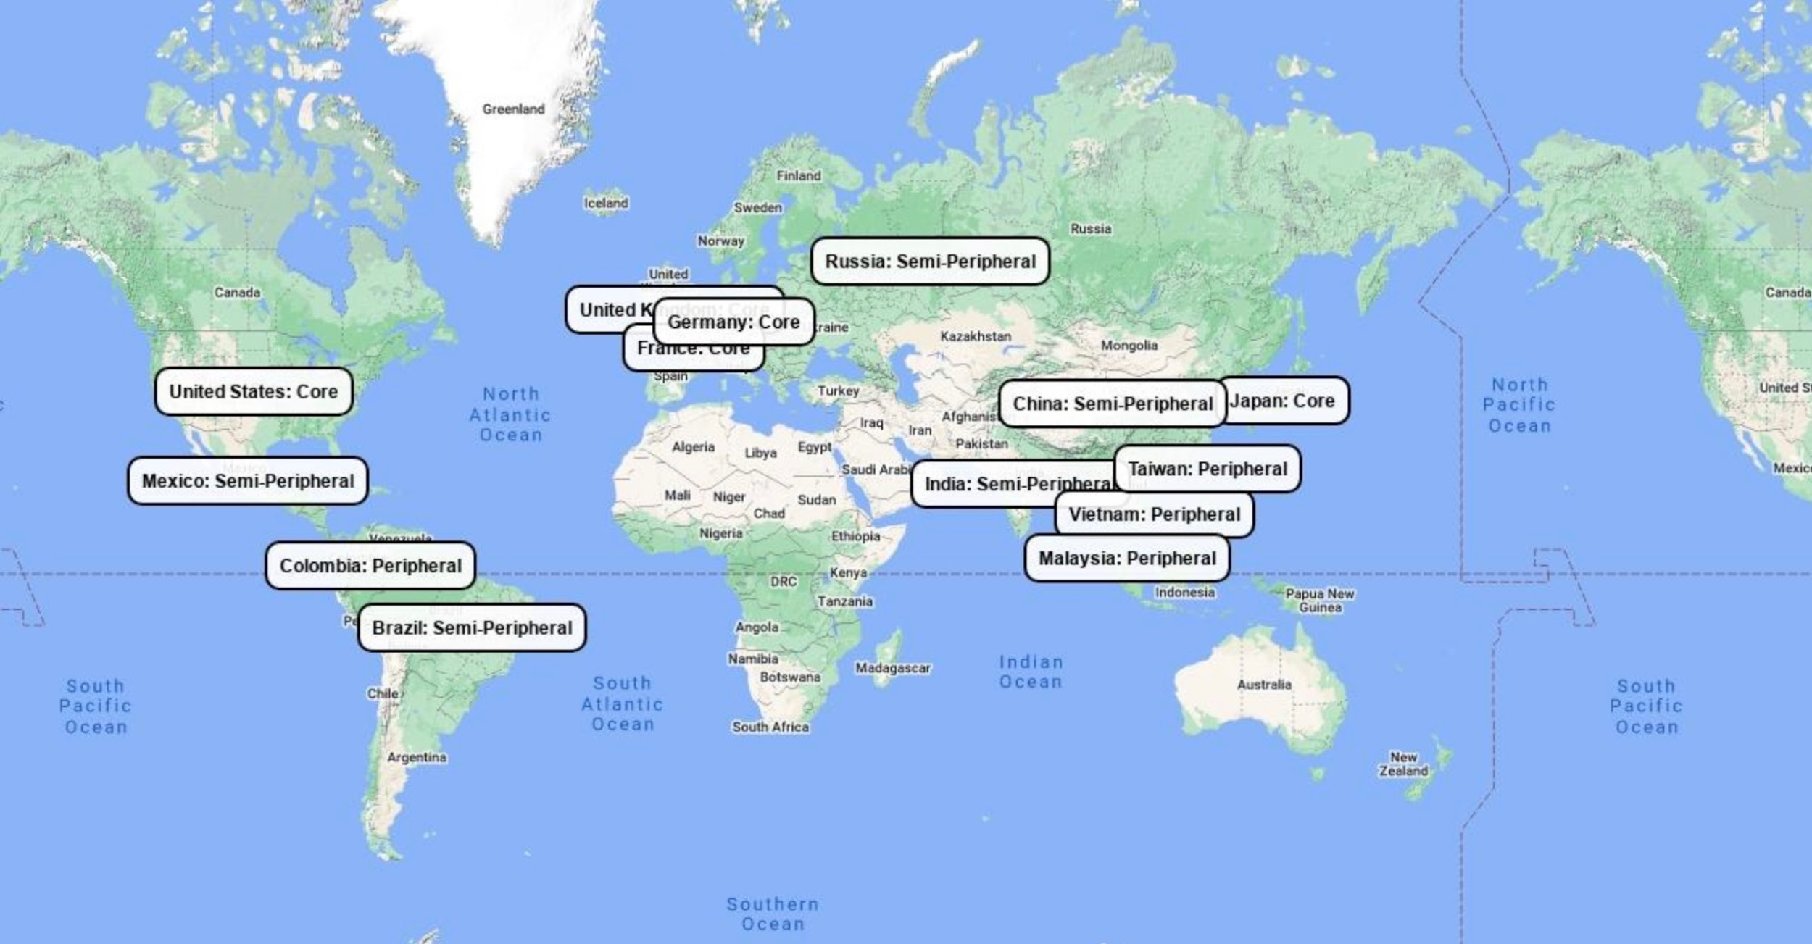

Slide 5
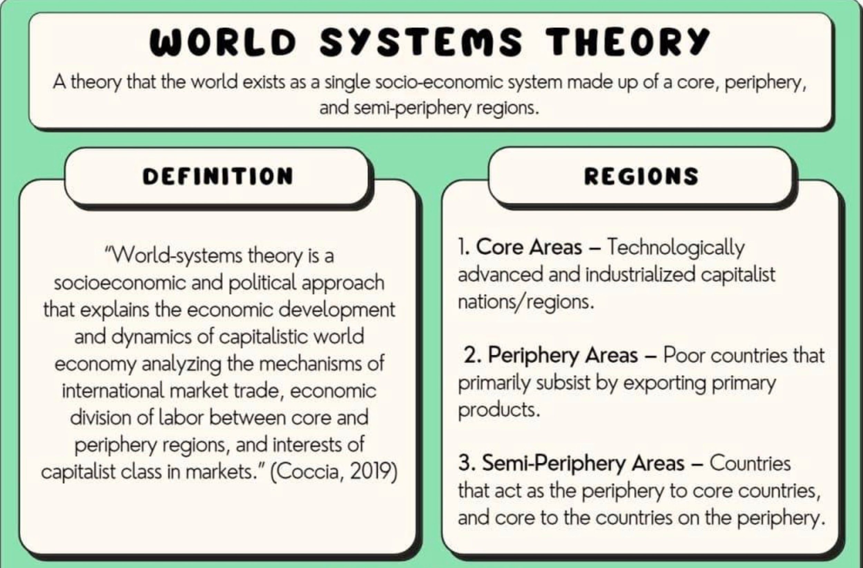

Slide 6
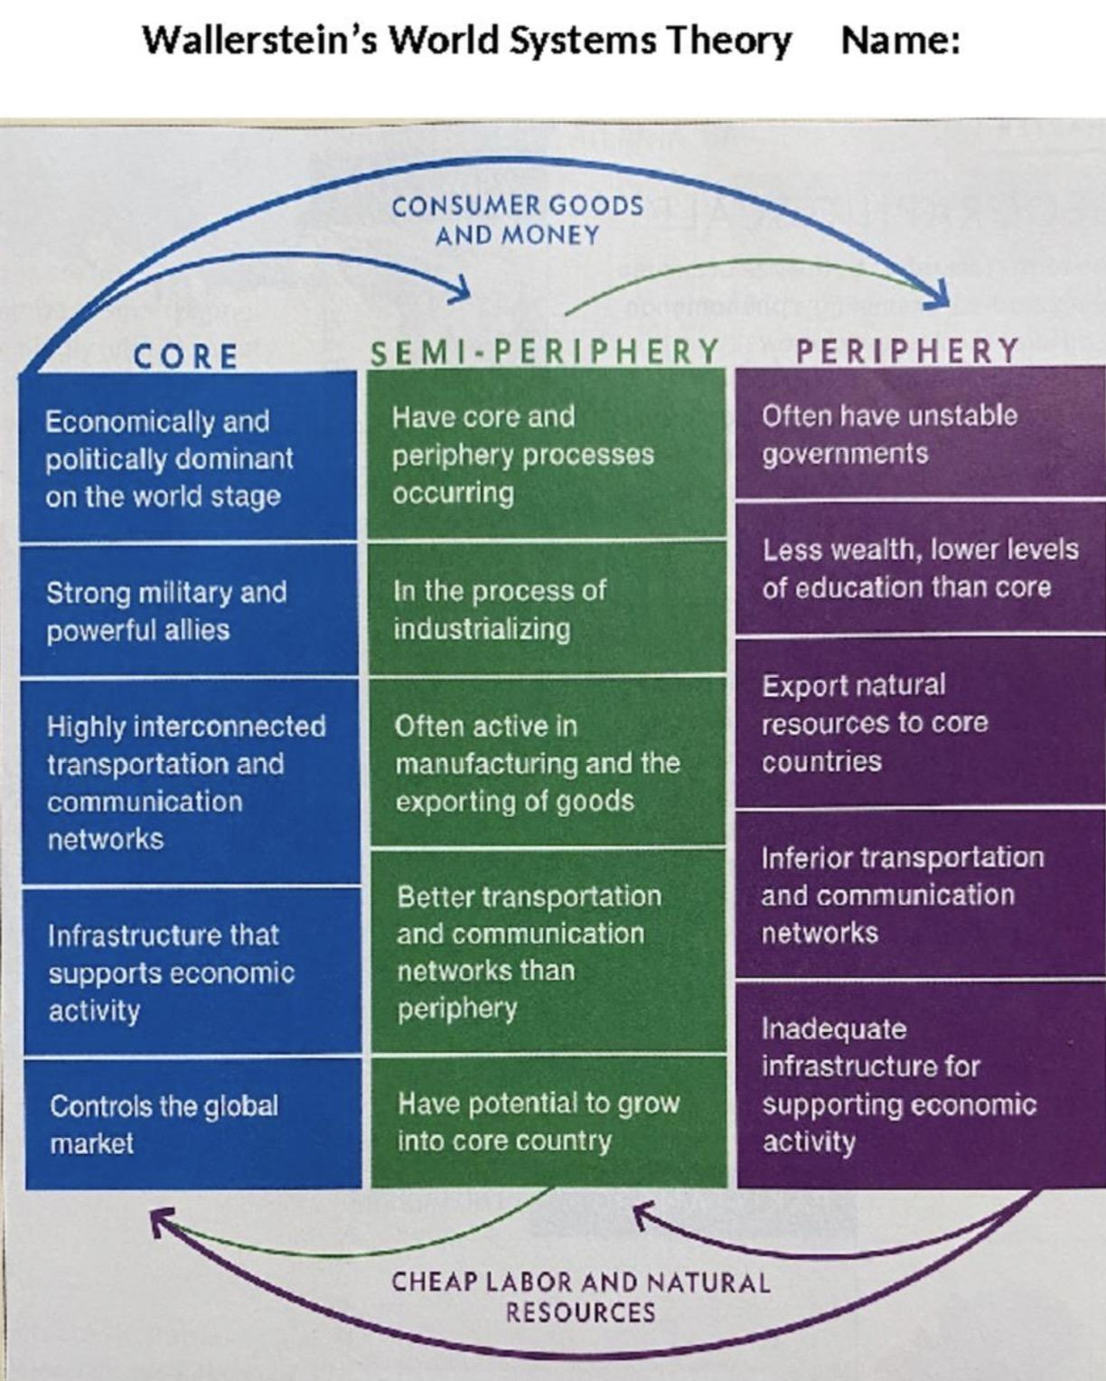

Slide 7
World-System Theory
World System Theory is an important approach in International Relations that explains the structure of the global economy and inequality among countries. The theory was mainly developed by sociologist Immanuel Wallerstein in the 1970s. It argues that the world should be understood as a single global economic system rather than separate national economies.
According to this theory, the modern world economy developed with the expansion of capitalism from Europe in the 16th century. The global system is structured in a hierarchical manner where powerful countries dominate weaker ones. Wallerstein divided the world into three main categories: Core, Semi-Periphery and Periphery.

Slide 8
Meaning of World-System Theory
World-System Theory argues that the world economy is a single interconnected system rather than a collection of independent national economies.
According to the theory,
Wealthy countries dominate and exploit poorer countries.
The global economy is structured in a hierarchy.
Economic and political power is concentrated in a few powerful states.

Slide 9
Main Structure of the World-System
Wallerstein divided the world into three major categories of states.
1. Core Countries
Core countries are the most developed and powerful states.
Characteristics:
1. Advanced technology and industries 2.Strong governments and military 3. High wages and skilled labor
4. Control of global markets and finance Examples: United States,Germany,Japan,United Kingdom
These countries benefit the most from the global capitalist system.
2. Periphery Countries
Periphery countries are the least developed and most exploited states.
Characteristics:
1.Weak economies 2.Dependence on exporting raw materials 3.Low wages and cheap labor
4.Political and economic dependence on core states. Examples:Many countries in Africa,Some countries in Latin America,Least developed countries in Asia
These countries provide resources and labor for core countries.
3. Semi-Periphery Countries
Semi-periphery countries fall between core and periphery.
Characteristics:
1.Moderate industrialization 2.Mixed economic structures 3. Both exploit periphery and are exploited by core
Growing economic power, Examples:Brazil,India,South, Africa,China (historically considered semi-periphery,though now moving toward core) Semi-periphery countries help stabilize the world system

Slide 10
Key Features of World-System Theory
1. Global Capitalist Economy
The world operates as a single capitalist system.
2. Division of Labour
Different regions specialize in different economic roles.
3. Unequal Exchange
Core countries gain more benefits than periphery countries.
4. Historical Development
The system began in Europe during the 16th century capitalist expansion.
5. Long-Term Inequality
Global inequality is a structural feature of the world economy.

Slide 11
Importance of World-System Theory in International Relations
1. Explains global economic inequality.
2. Highlights power relations in the world economy.
3. Shows how historical capitalism shaped international politics.
4. Helps understand development and underdevelopment.
For example, developing countries like Nepal often face structural disadvantages in the global economic system.

Slide 12
Merits of World System Theory
Provides a global perspective of economic relations.
Explains inequality between rich and poor countries.
Connects politics, economics, and history.
Helps understand dependency and development issues.
Demerits of World System Theory
Overemphasis on economic factors.
Underestimates the role of national policies and institutions.
Some countries successfully move upward in the system.
Critics say it is too deterministic.

Slide 13
Theories of International Relations - Game Theory

Slide 14
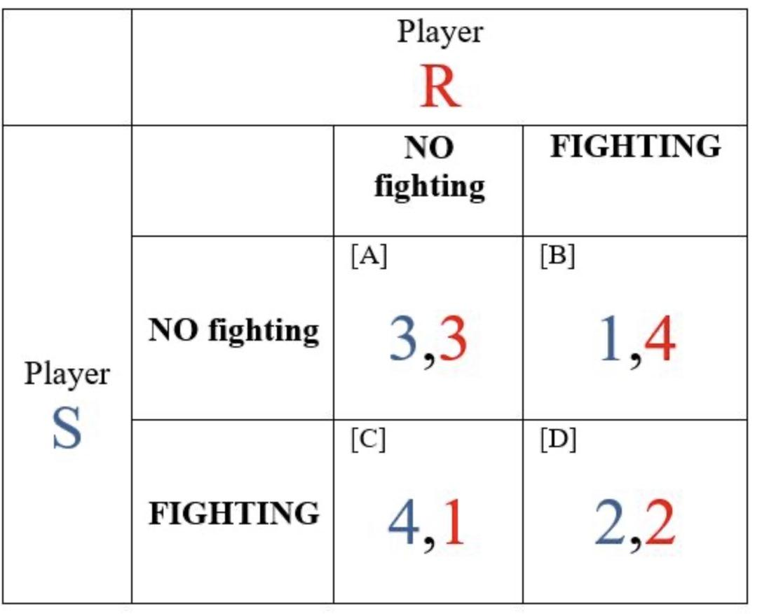

Slide 15
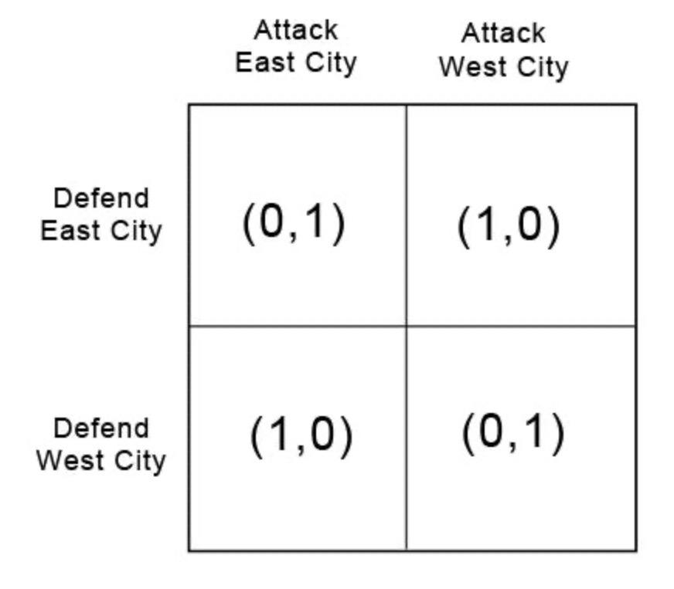

Slide 16
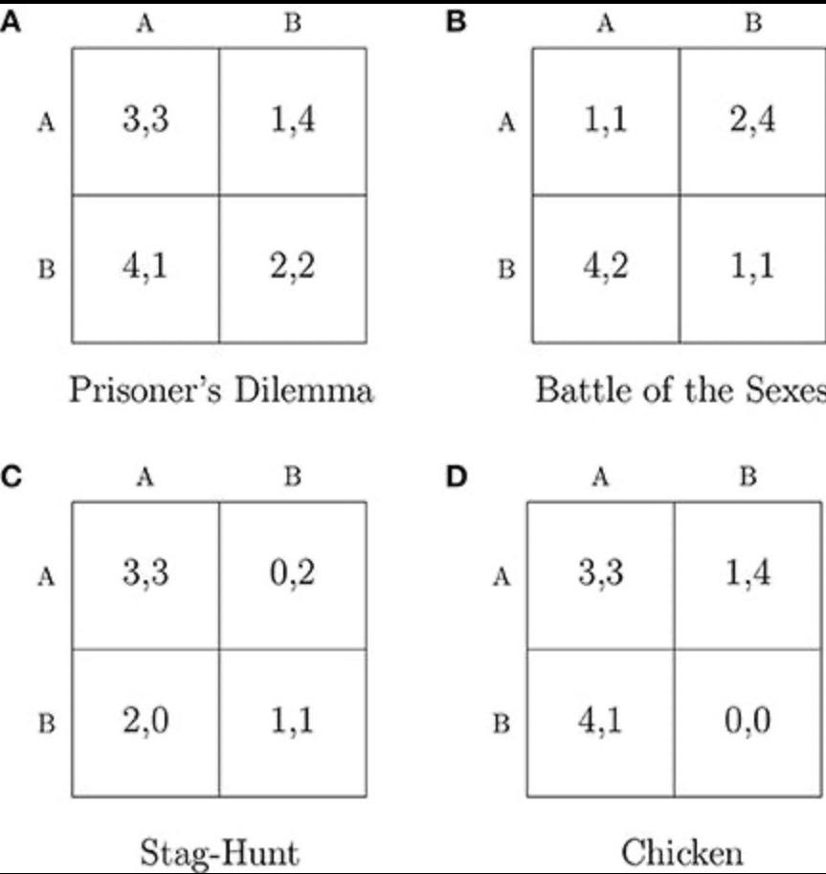

Slide 17
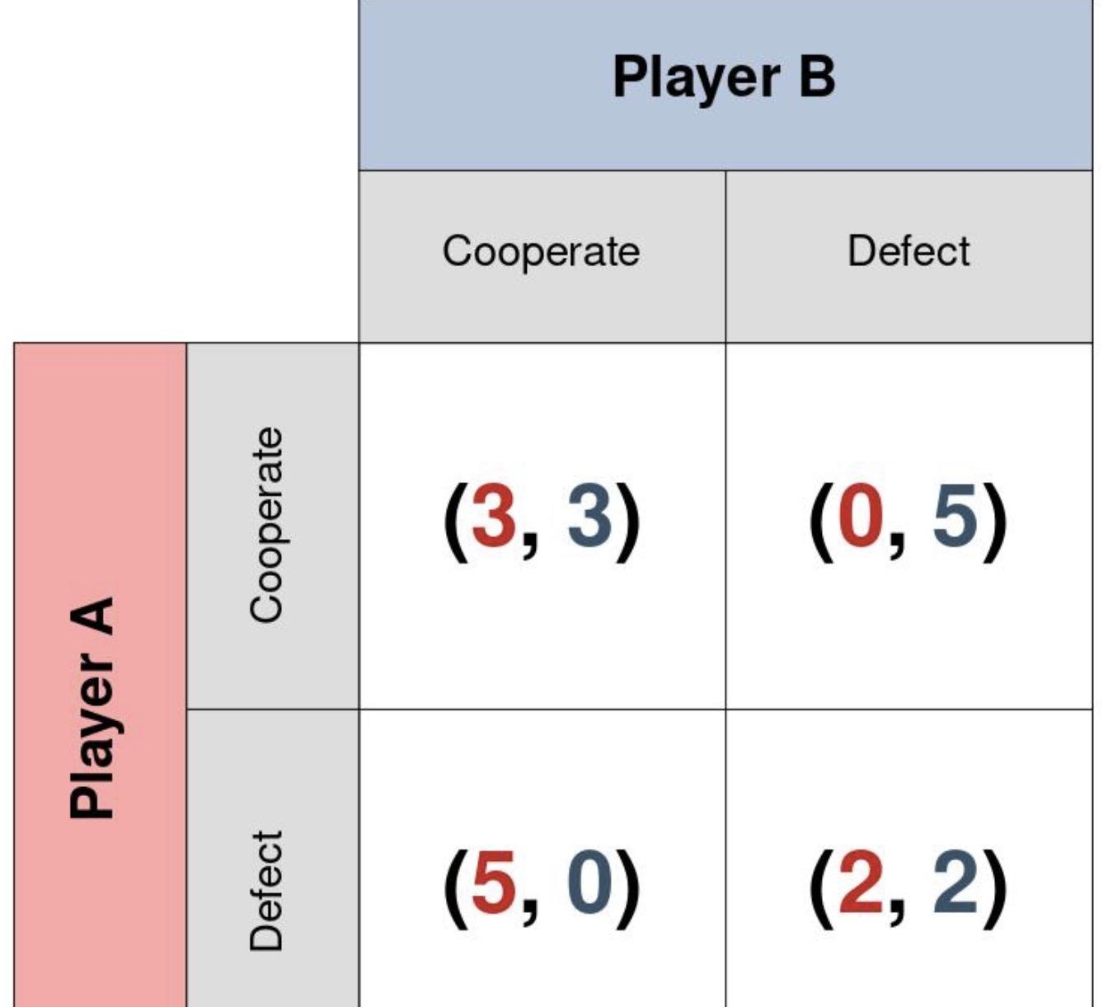

Slide 18
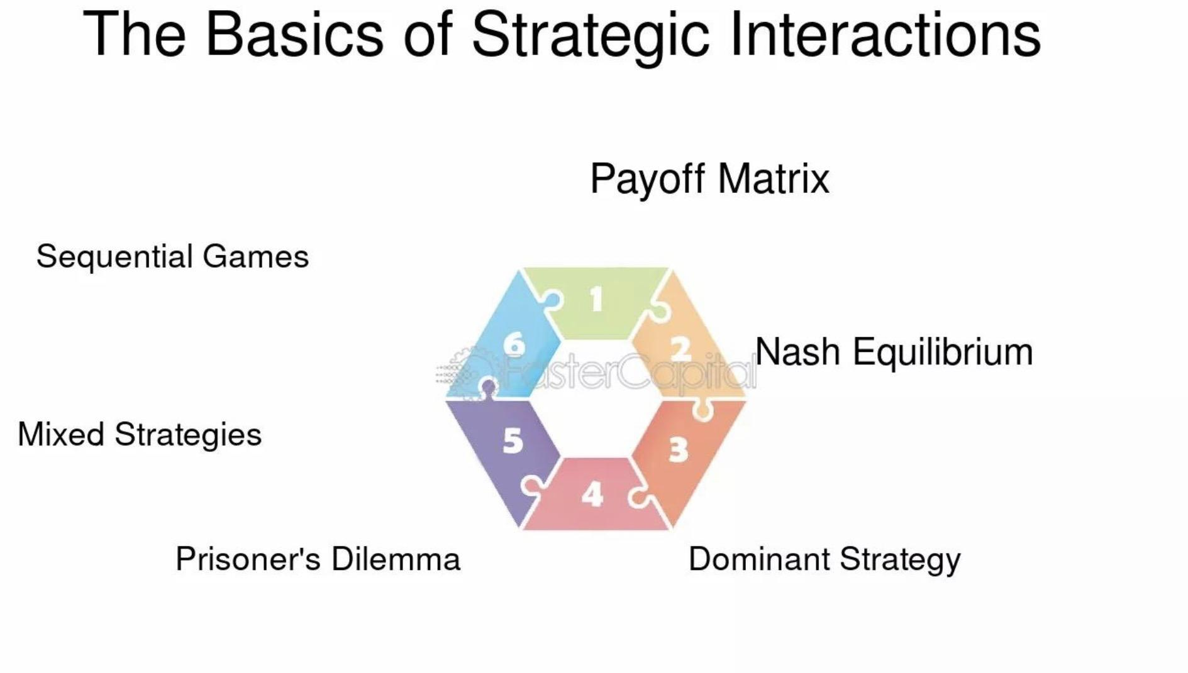

Slide 19
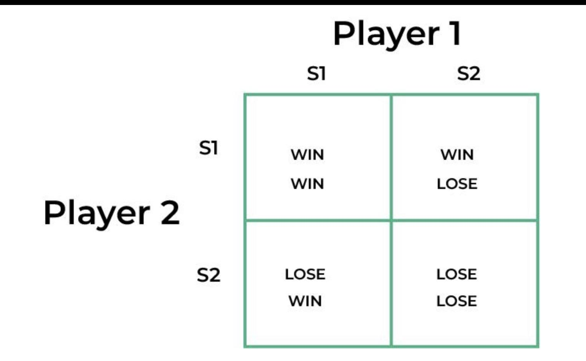

Slide 20
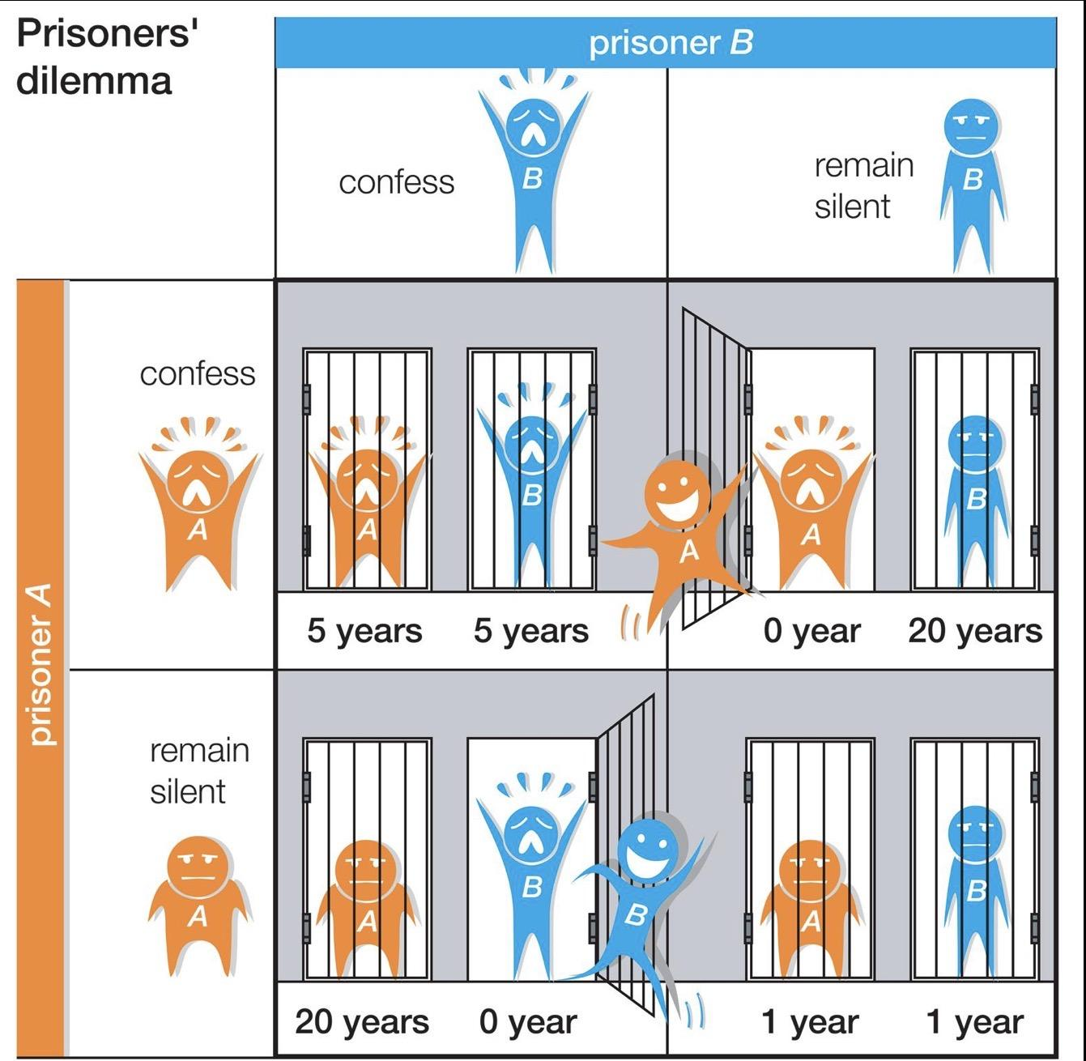

Slide 21
Game Theory is an analytical approach in International Relations used to study strategic interactions between states or actors. It examines how decision makers choose strategies when the outcome of their actions depends on the actions of others.
The theory was initially developed in mathematics and economics, especially through the work of John von Neumann and Oskar Morgenstern in their book Theory of Games and Economic Behavior (1944). Later, it was applied to international politics during the Cold War to analyze conflicts, alliances and cooperation.

Slide 22
Meaning of Game Theory
Game Theory studies situations of conflict and cooperation where actors must make strategic decision
In international relations:
States act like players in a game.
Each state chooses strategies based on expected reactions of other states.
The final outcome depends on the combined decisions of all players.
Game theory helps explain issues such as war, diplomacy, nuclear deterrence and international negotiations.
Key Elements of Game Theory
Players
Actors involved in the game (usually states or international organizations).
Strategies
The choices available to players.
Payoffs
The outcomes or benefits players receive from different strategies.
Rules of the Game
The framework within which decisions are made.

Slide 23
Types of Games in International Relations
1. Zero-Sum Game
One player’s gain equals another player’s loss.
Total benefit remains constant.
Example: Military conflict or territorial competition.
2. Non-Zero-Sum Game
Both players may gain or lose simultaneously.
Cooperation can produce mutual benefits.
Example: Trade agreements or climate cooperation.
3. Prisoner’s Dilemma
One of the most famous models in game theory.
Two actors must decide whether to cooperate or defect.
Mutual cooperation produces the best collective outcome.
However, fear and mistrust often lead both sides to defect.
This model helps explain problems like arms races and security dilemmas between states.

Slide 24
Importance of Game Theory in International Relations
Helps explain strategic decision making among states.
Useful in studying conflict, war and diplomacy.
Explains nuclear deterrence during the Cold War.
Helps analyze cooperation and negotiations between countries.
Provides a scientific and mathematical approach to political analysis.
Merits of Game Theory
Provides clear analytical tools for studying strategic behavior.
Helps explain conflict and cooperation between states.
Useful for analyzing diplomacy and negotiation strategies.
Widely applied in economics, politics and international relations.
Demerits
Overly mathematical and abstract.
Assumes actors are fully rational, which may not always be true.
Simplifies complex political realities.
Ignores cultural, historical and emotional factors in decision-making.

Slide 25
Decision Making Theory in International Relations
Decision Making Theory is an important approach in International Relations that focuses on how foreign policy decisions are made by leaders and governments. Instead of only studying the international system, this theory examines the process, psychology and institutions behind state decisions.
This approach became prominent in the 1950s and 1960s through the work of scholars such as Richard C. Snyder, H. W. Bruck and Burton Sapin.
Meaning of Decision-Making Theory
Decision-Making Theory argues that state actions in international politics are the result of decisions made by individuals and groups within government.
The theory emphasizes that foreign policy is influenced by:
Leaders and policymakers
Psychological perceptions and beliefs
Bureaucratic organizations
Domestic political pressures
Thus, the behavior of a state cannot be understood without examining who makes the decisions and how those decisions are made.

Slide 26
Key Features of Decision-Making Theory
1.Focus on Decision Makers
It studies leaders, diplomats and policymakers who shape foreign policy.
2.Role of Perception and Psychology
Leaders’ beliefs, values and perceptions influence their decisions.
3. Importance of Information
Decisions depend on available information and how it is interpreted.
4.Bureaucratic Influence
Government institutions and bureaucracies affect policy outcomes.
5.Domestic Context
Public opinion, political parties and national interests influence decisions.

Slide 27
Importance in International Relations
Helps explain foreign policy behavior of states.
Highlights the role of leaders and policymakers in international politics.
Explains why states sometimes act irrationally or unexpectedly.
Connects domestic politics with international relations.
Merits of Decision Making Theory
Provides a realistic understanding of foreign policy processes.
Emphasizes the role of human behavior and leadership.
Helps explain different responses of states in similar situations.
Integrates psychological and organizational factors into IR analysis.
Demerits of Decision Making Theory
Too complex and difficult to study empirically.
May ignore broader structural factors of the international system.
Overemphasis on individual leaders.
Difficult to generalize because decision processes vary among states.

Slide 28
Geopolitical Theory
Geopolitical Theory is an important approach in International Relations that examines how geographical factors influence political power, foreign policy and international relations among states. The theory argues that geography such as location, natural resources, climate, population distribution and access to seas plays a crucial role in shaping the behavior and power of nations.
The term geopolitics was first introduced by the Swedish political scientist Rudolf Kjellén in the early twentieth century. Later, several scholars expanded the theory, particularly Halford Mackinder and Nicholas J. Spykman, whose ideas significantly influenced strategic thinking and foreign policy.
Geopolitical theory became especially important during the twentieth century as major powers used geographical analysis to formulate military strategies, alliances and global political policies.
Meaning of Geopolitical Theory
Geopolitical Theory refers to the study of the relationship between geography and political power. It emphasizes that the physical environment and location of a country strongly affect its political development, security strategies, economic power and international influence.
According to this theory, countries located in strategic geographical positions, such as near important trade routes, oceans, or resource rich areas, often possess greater advantages in global politics.
Thus, geopolitical theory suggests that international politics cannot be fully understood without considering geographical factors.

Slide 29
Key Elements of Geopolitics
Several geographical factors influence international relations:
1. Location
The geographical location of a country determines its strategic importance. Countries located between powerful states or near important sea routes often have greater geopolitical significance.
2. Natural Resources
Access to resources such as oil, minerals, water and fertile land increases the economic and strategic strength of a country.
3. Physical Features
Mountains, rivers, deserts and oceans influence defense strategies and political boundaries.
4. Population and Territory
Large territory and population can increase a country’s military and economic potential.
5. Strategic Routes
Control of trade routes, maritime passages and transportation networks enhances geopolitical power.

Slide 30
Major Geopolitical Theories
1. Heartland Theory
The Heartland Theory was proposed by Halford Mackinder in 1904. He argued that the central region of Eurasia, known as the Heartland, is the most strategically important area in the world.
Mackinder believed that a power controlling this region could dominate the world because it was rich in resources and difficult to invade.
His famous statement was:
“Who rules Eastern Europe commands the Heartland
Who rules the Heartland commands the World-Island
Who rules the World-Island commands the world.”
The World-Island referred to the combined continents of Europe, Asia and Africa.
Rimland Theory
The Rimland Theory was developed by Nicholas J. Spykman as a response to Mackinder’s idea.
Spykman argued that the coastal areas surrounding Eurasia, known as the Rimland, were more important than the Heartland.
According to him:
“Who controls the Rimland rules Eurasia
Who rules Eurasia controls the destinies of the world.”
The Rimland includes regions such as Western Europe, the Middle East, South Asia, and East Asia.

Slide 31
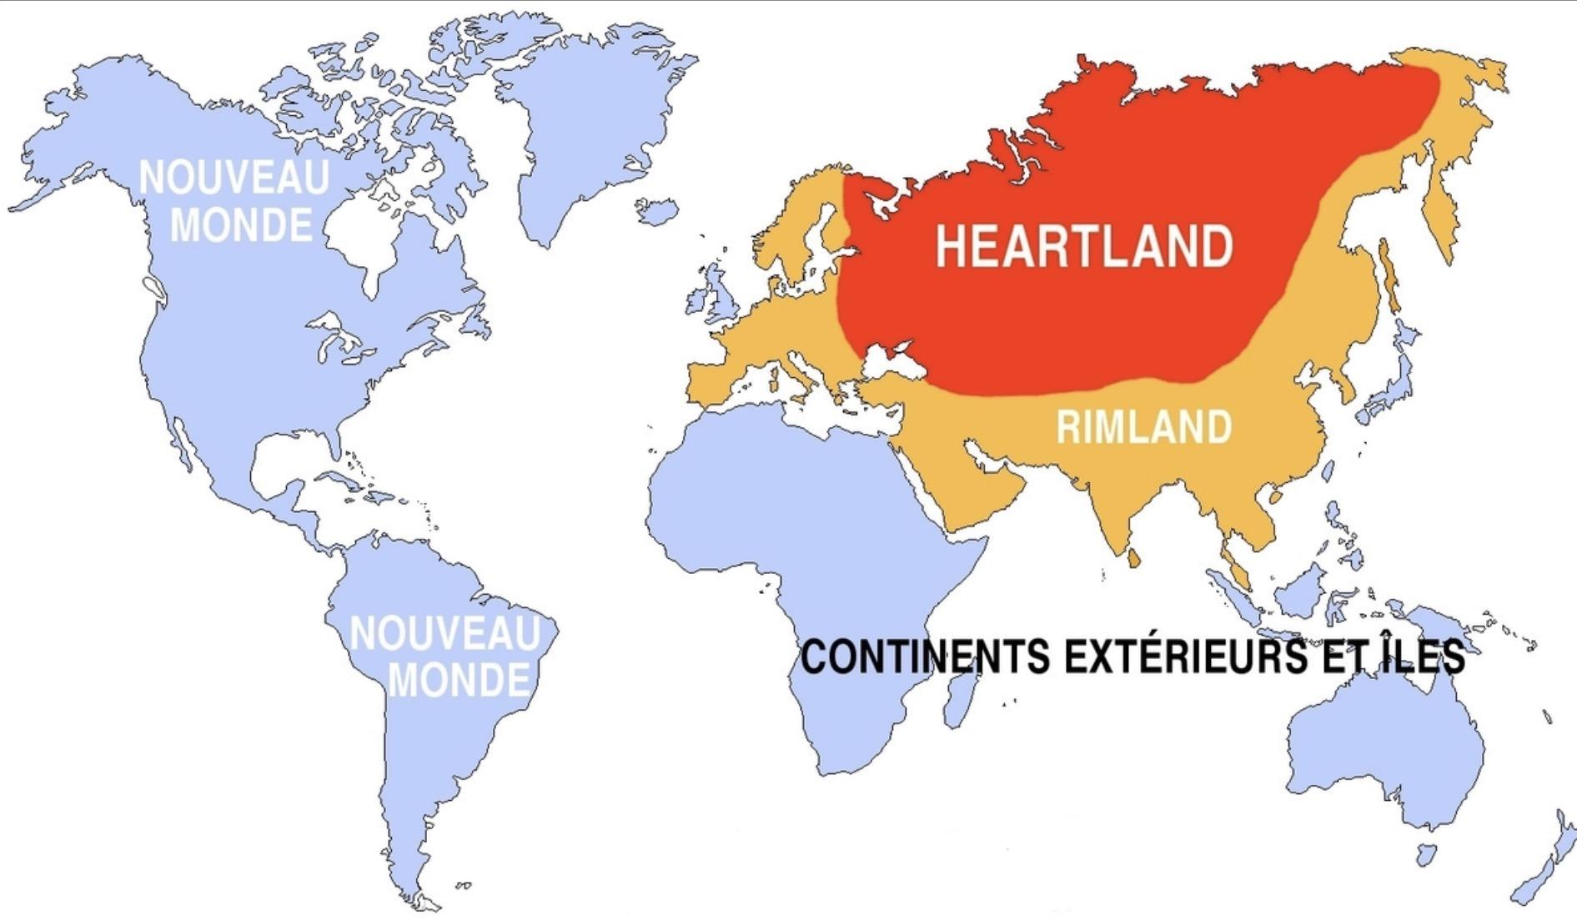

Slide 32
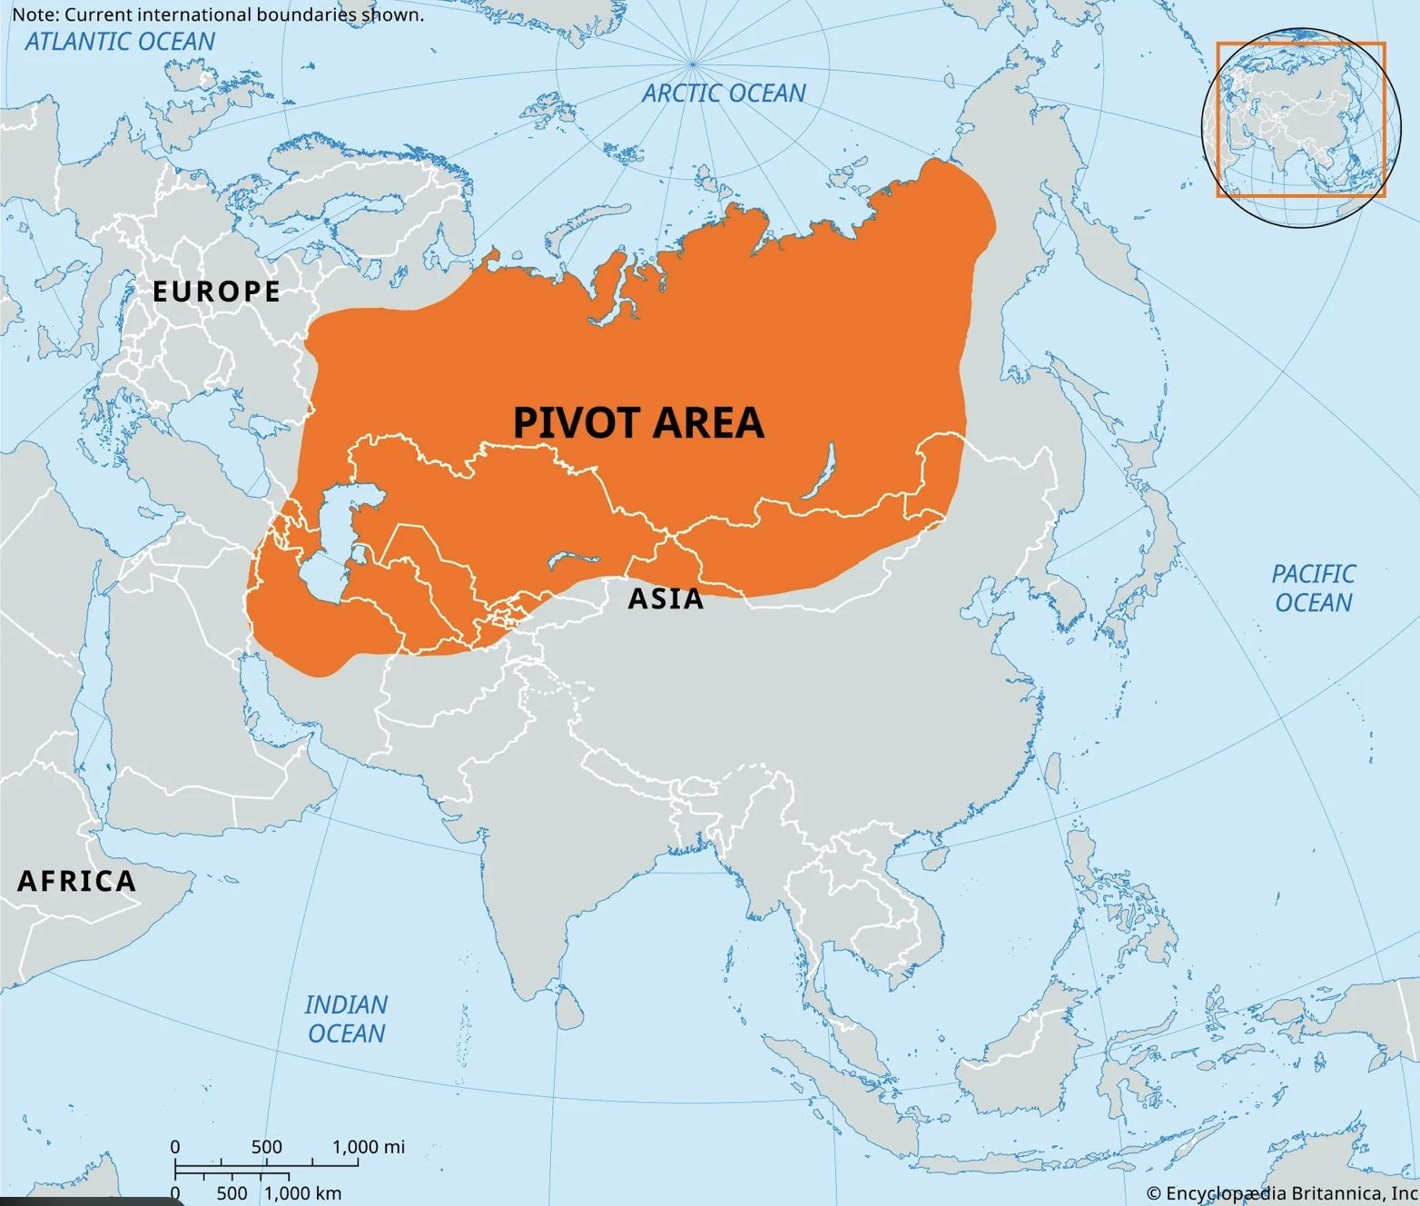

Slide 33
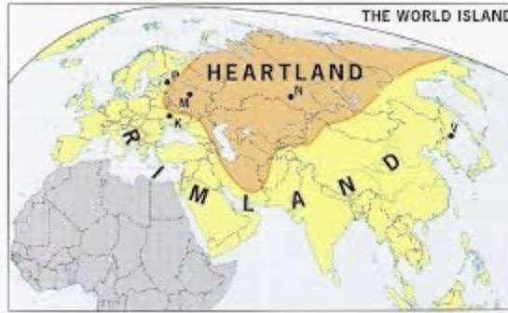

Slide 34
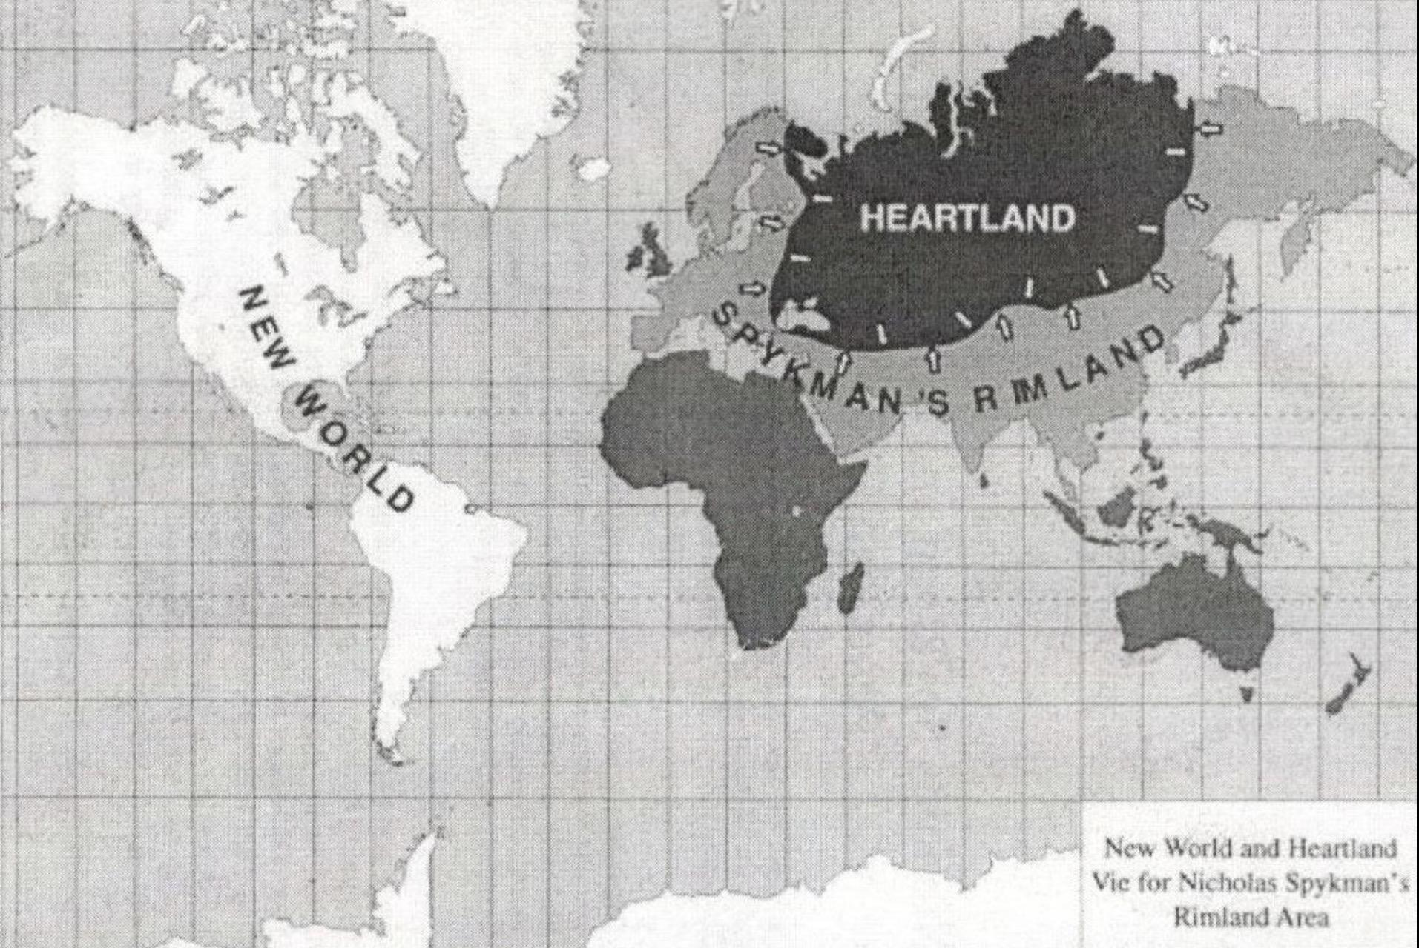

Slide 35
Importance of Geopolitical Theory in International Relations
Geopolitical theory plays an important role in understanding global politics for several reasons:
Explains power politics among states by analyzing geographical advantages and disadvantages.
Helps understand military strategies and defense planning.
Explains the foreign policies of major powers and their strategic alliances.
Helps analyze territorial conflicts and border disputes.
Assists in understanding competition for natural resources and trade routes.
For instance, the geopolitical position of Nepal between two major powers India and China greatly influences its foreign policy and diplomatic strategies.

Slide 36
Merits of Geopolitical Theory
Highlights the importance of geography in international politics.
Helps explain strategic behavior and foreign policy decisions of states.
Useful for analyzing military and security strategies.
Provides a practical framework for understanding global power distribution.
Helps policymakers understand the strategic significance of regions and territories.
Demerits
Geographical Determinism: The theory sometimes overemphasizes geography as the main determinant of political power.
Ignores Non Geographical Factors:It gives less importance to economic, social, cultural and ideological factors.
Technological Changes:Modern technology, air power and globalization have reduced some geographical barriers.
Political Misuse:In some cases, geopolitical arguments have been used to justify imperialism or expansionist policies.
Oversimplification of Global Politics: International relations are influenced by many factors beyond geography alone.

